Slide 1



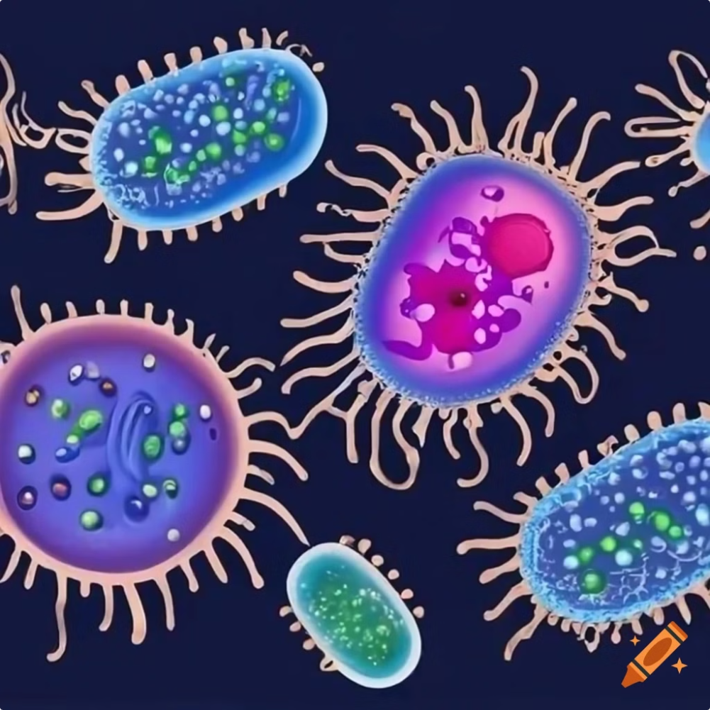
Antimicrobial Resistance (AMR): A Growing Threat
Antimicrobial Resistance (AMR) occurs when microbes—like bacteria, viruses, fungi, and parasites—evolve to resist the effects of drugs, especially antibiotics, making treatments ineffective. This resistance develops due to the overuse or misuse of antimicrobial medications, leading to the creation of "superbugs" that are difficult to treat. As a result, once-treatable infections become life-threatening.
by Atharva Exam Wise

Slide 2

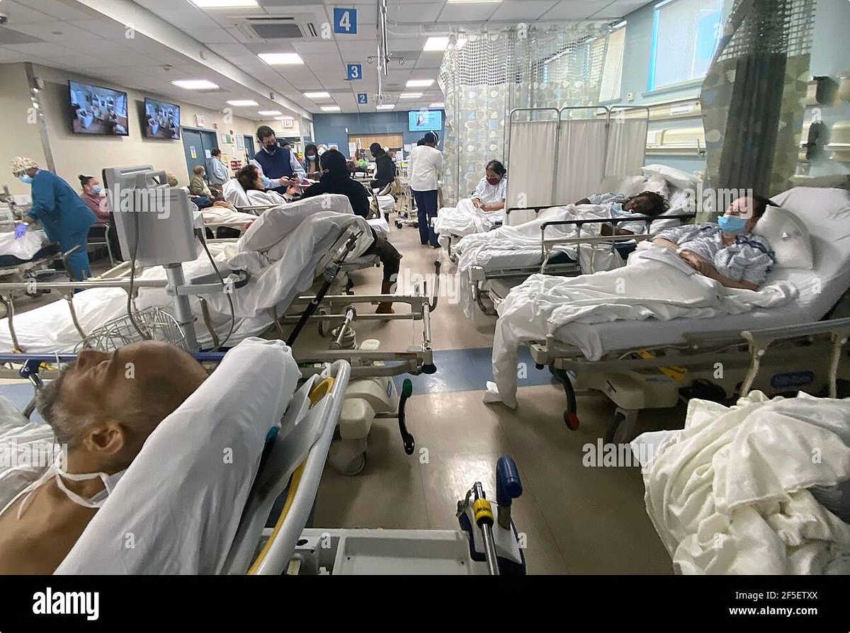
Why is AMR a Grave Concern?
1
Escalating Healthcare Costs
Routine infections are becoming more difficult to treat, leading to extended hospital stays, more expensive treatments, and higher mortality rates.
2
Global Public Health Threat
AMR affects all regions, but its impact is pronounced in countries with high infection rates and weaker healthcare systems.
3
Vulnerable Populations
Individuals with compromised immune systems, or those suffering from multiple diseases, face higher risks of complications from drug-resistant infections.

Slide 3

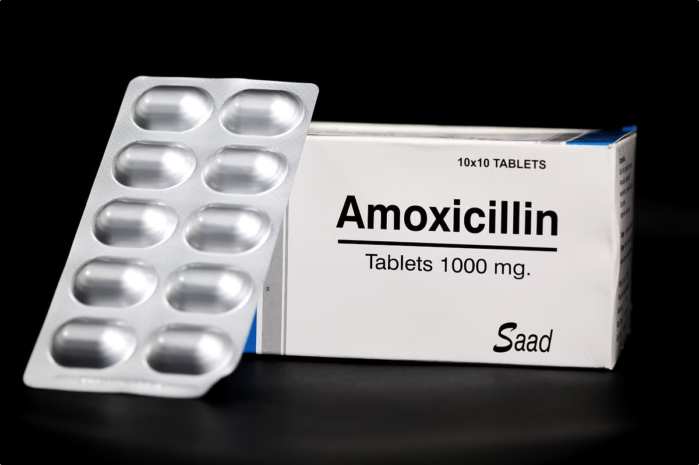
Key Factors Driving AMR in India
1
Public Misuse of Antibiotics
In India, people frequently consume antibiotics without prescriptions, even for viral infections where antibiotics are ineffective.
2
Empirical Prescriptions
Many doctors prescribe broad-spectrum antibiotics without definitive diagnostic tests, hastening the rise of resistance.
3
Overuse in Hospitals
Antibiotics are often used excessively in hospitals, sometimes to prevent infections rather than treat them.
4
Pharmaceutical Pollution
Antibiotic production facilities are contributing to the spread of resistant bacteria due to inadequate waste management, which leads to environmental contamination.

Slide 4

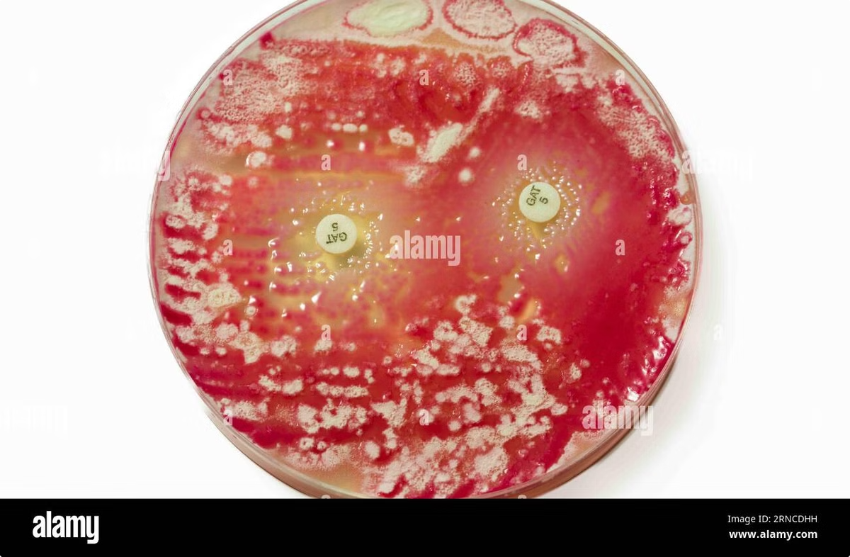
Most Common Resistant Pathogens in India
Pathogen
Description
Resistance
E. coli
Known for causing gut infections
Increasing resistance to carbapenems, a critical class of antibiotics
Klebsiella pneumoniae
Cause of pneumonia and urinary tract infections
Reduced effectiveness from critical antibiotics
Acinetobacter baumannii
Frequently found in hospital-acquired infections
Demonstrates high resistance to strong antibiotics like carbapenems

Slide 5





Measures to Combat AMR: Prevention
Improve Hygiene
Enhance sanitation practices to prevent the spread of infections.
Promote Vaccination
Encourage vaccination campaigns (e.g., pneumococcal and influenza vaccines).
Public Education
Raise awareness about the importance of proper antibiotic use.

Slide 6


Measures to Combat AMR: Doctor Education
Appropriate Antibiotic Use
Diagnostic Testing
Prescribing Guidelines
Encourage the use of diagnostic tests to tailor treatments.
Adhere to evidence-based prescribing guidelines to reduce unnecessary antibiotic use.
Ensure appropriate antibiotic use, reserving potent antibiotics for severe hospital-based cases.

Slide 7


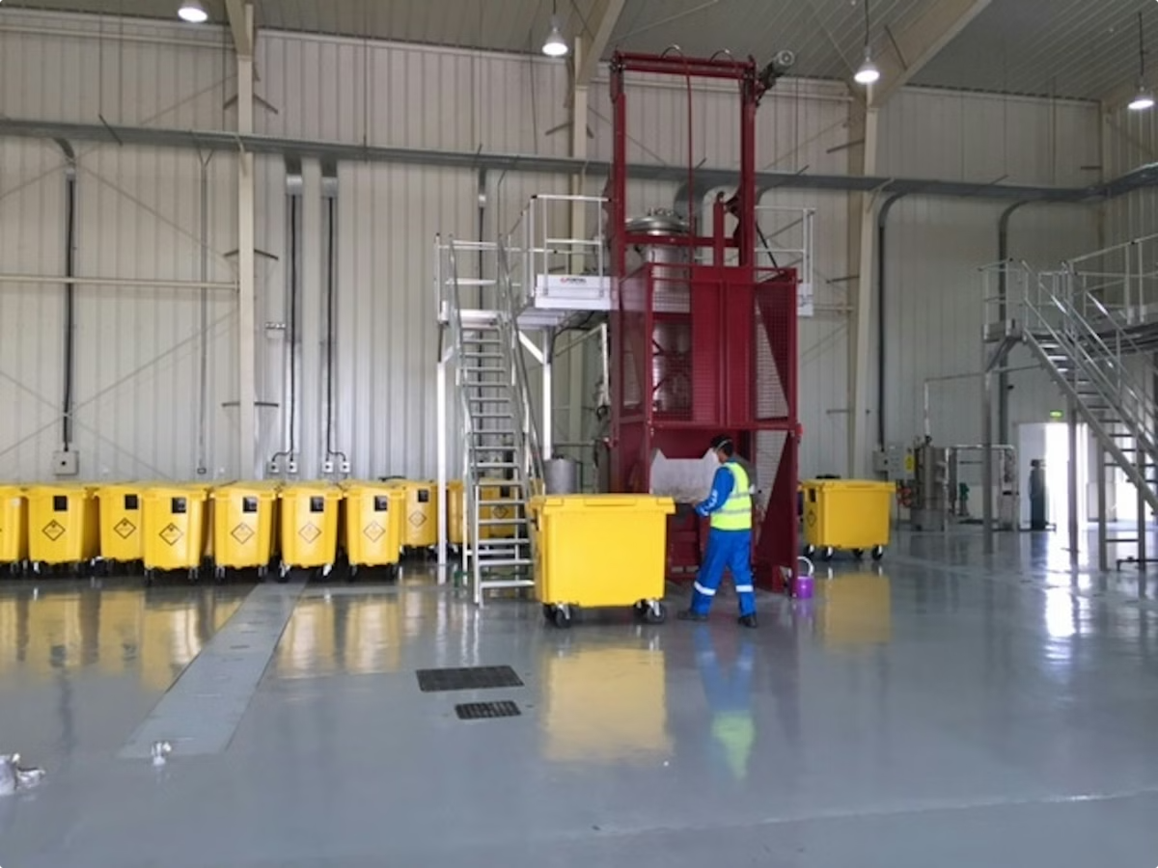


Measures to Combat AMR: Pharmaceutical Regulation
Strict Regulations
Introduce strict regulations on waste management in antibiotic manufacturing.
Environmental Protection
Implement measures to limit environmental contamination from pharmaceutical waste.
Monitoring and Enforcement
Establish systems to monitor compliance and enforce regulations in the pharmaceutical industry.

Slide 8

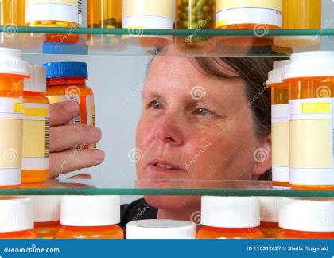
What Can Be Done? Individual Level
1
Avoid Self-Medication
2
Complete Prescribed Courses
3
Practice Good Hygiene
Avoid self-medicating with antibiotics; consult healthcare professionals before taking any.
Maintain good personal hygiene to prevent the spread of infections.
Always complete the full course of antibiotics as prescribed by your doctor.

Slide 9
What Can Be Done? Doctor's Level
Prescribe Responsibly
Educate Patients
Stay Informed
Prescribe antibiotics only when necessary, and prioritize narrow-spectrum antibiotics after confirming the infection type.
Inform patients about the proper use of antibiotics and the risks of antimicrobial resistance.
Keep up-to-date with the latest guidelines and research on antimicrobial resistance.

Slide 10

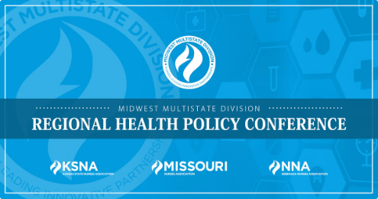
What Can Be Done? Government and Healthcare Systems
Public Health Campaigns
Regulate Pharmaceutical Waste
Invest in public health campaigns promoting responsible antibiotic use.
Implement and enforce regulations on pharmaceutical waste management.
Boost Surveillance
Coordinated Action
Enhance surveillance efforts to track and combat the spread of AMR.
As AMR continues to rise, especially in countries like India, it's critical for governments, the medical community, and individuals to take coordinated action to prevent a future where minor infections can no longer be treated effectively.

